Slide 1

TELECOM CUSTOMER CHURN PREDICTION
Soumyajit Behera

Slide 2


Slide 3
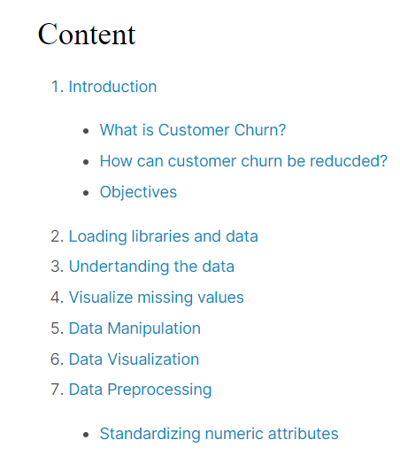
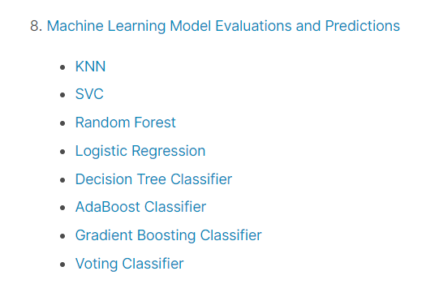

Slide 4
1. Introduction
What is Customer Churn?
Customer churn is defined as when customers or subscribers discontinue doing business with a firm or service.
Customers in the telecom industry can choose from a variety of service providers and actively switch from one to the next. The telecommunications business has an annual churn rate of 15-25 percent in this highly competitive market.
Individualized customer retention is tough because most firms have a large number of customers and can't afford to devote much time to each of them. The costs would be too great, outweighing the additional revenue. However, if a corporation could forecast which customers are likely to leave ahead of time, it could focus customer retention efforts only on these "high risk" clients. The ultimate goal is to expand its coverage area and retrieve more customers loyalty. The core to succeed in this market lies in the customer itself.
To reduce customer churn, telecom companies need to predict which customers are at high risk of churn.
To detect early signs of potential churn, one must first develop a holistic view of the customers and their interactions across numerous channels, including store/branch visits, product purchase histories, customer service calls, Web-based transactions, and social media interactions, to mention a few.

Slide 5
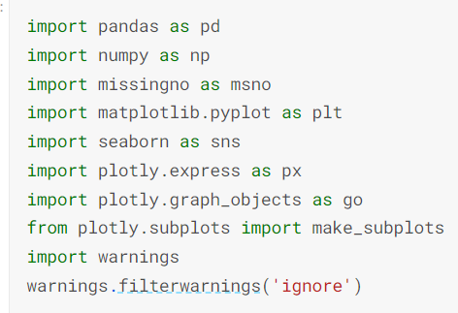
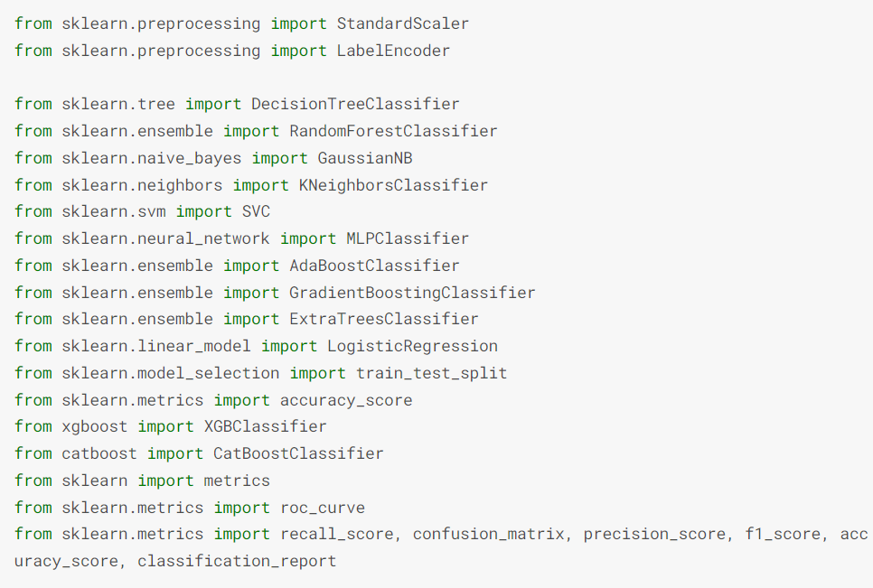
2. Loading libraries and data

Slide 6
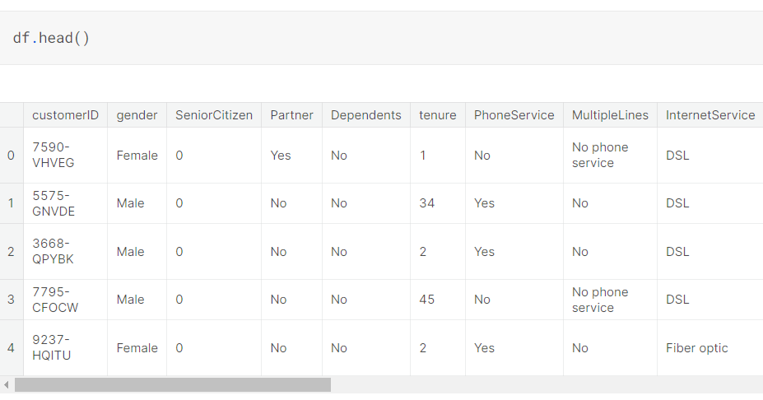
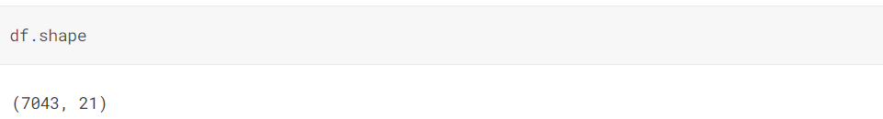
df = pd.read_csv(r"C:\Users\neeko\Dropbox\PC\Downloads\WA_Fn-UseC_-Telco-Customer-Churn.csv")
3. Undertanding the data

Slide 7
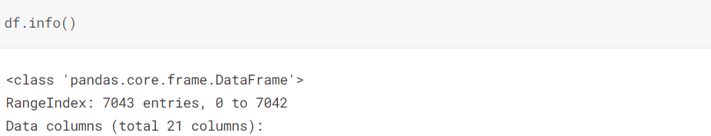
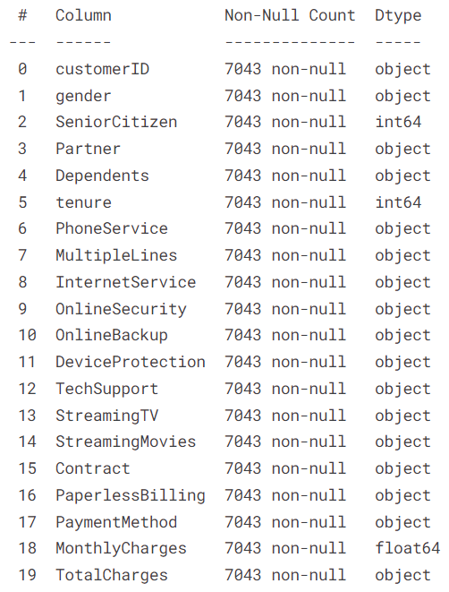


Slide 8
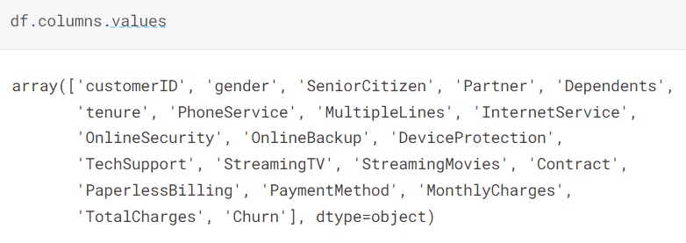
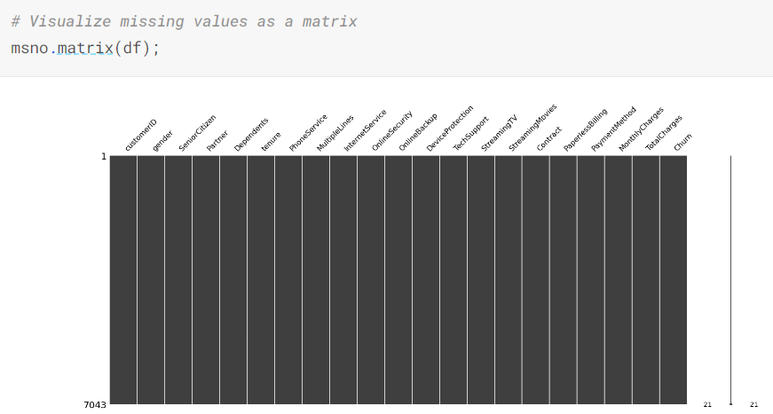
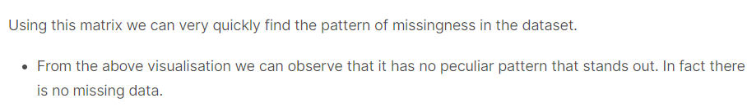
4. Visualize missing values

Slide 9


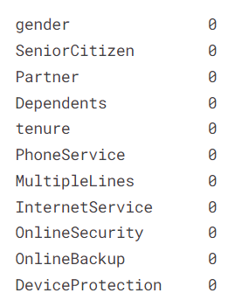
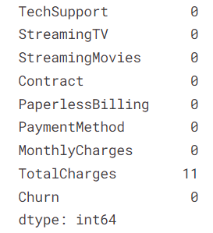
5. Data Manipulation
Here we see that the TotalCharges has 11 missing values. Let's check this data

Slide 10

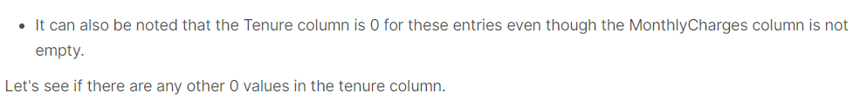
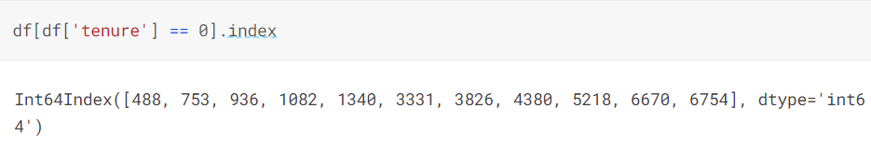
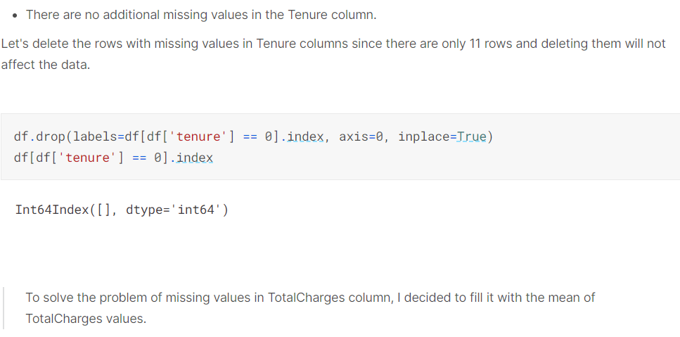

Slide 11


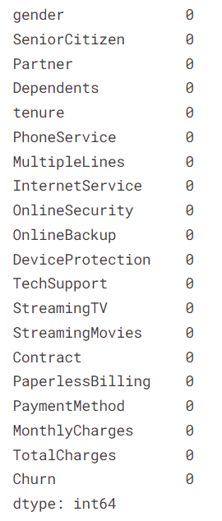

Slide 12

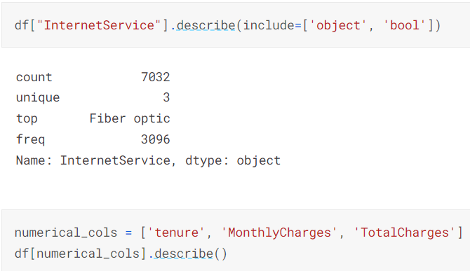
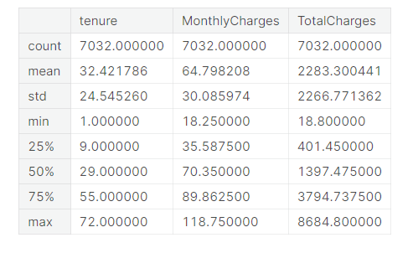

Slide 13
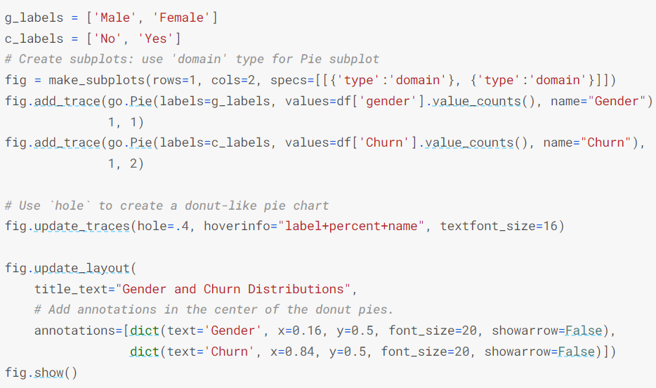
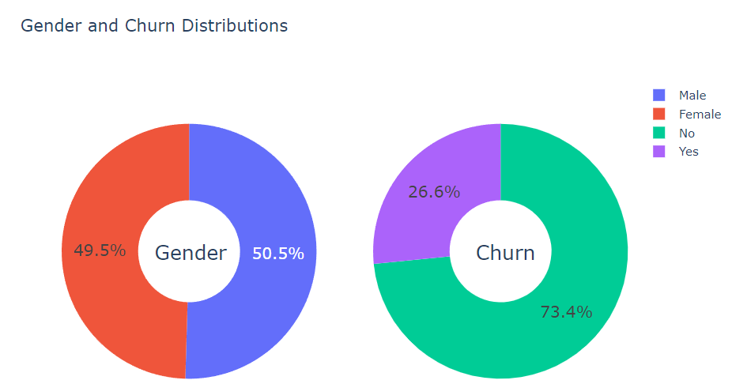
6. Data Visualization
26.6 % of customers switched to another firm.
Customers are 49.5 % female and 50.5 % male.

Slide 14
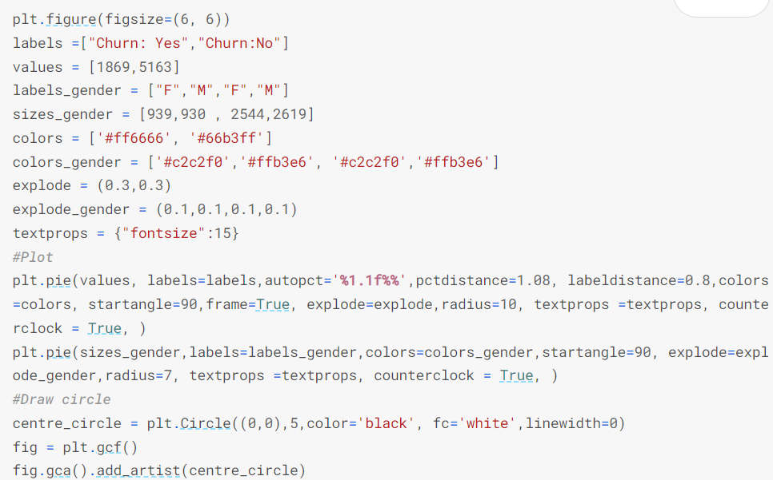
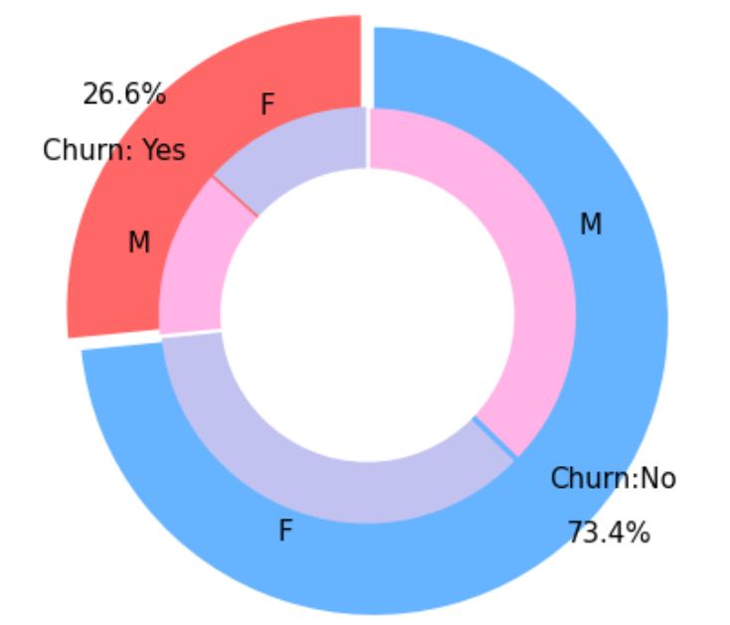
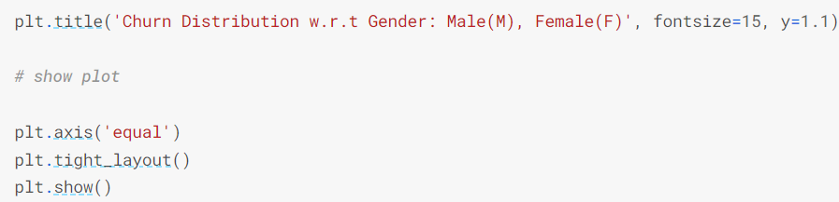
There is negligible difference in customer percentage/ count who chnaged the service provider. Both genders behaved in similar fashion when it comes to migrating to another service provider/firm.

Slide 15
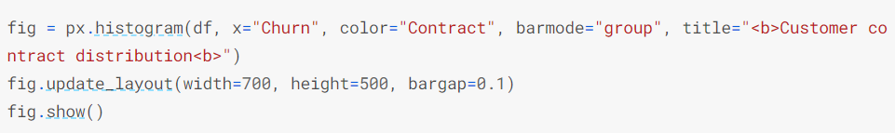
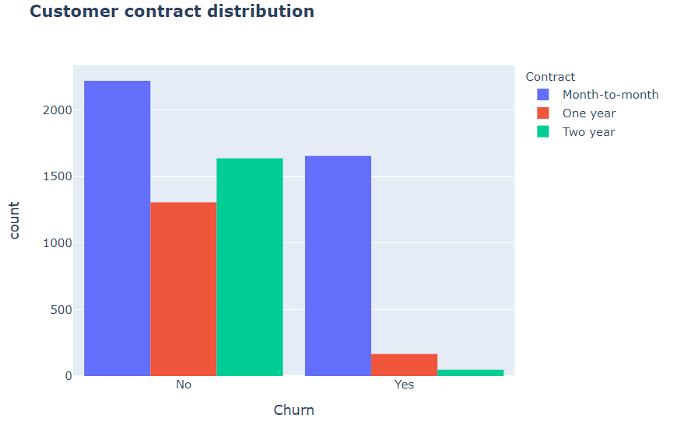
About 75% of customer with Month-to-Month Contract opted to move out as compared to 13% of customrs with One Year Contract and 3% with Two Year Contract

Slide 16
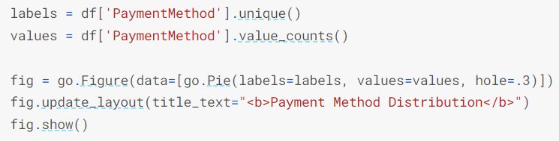
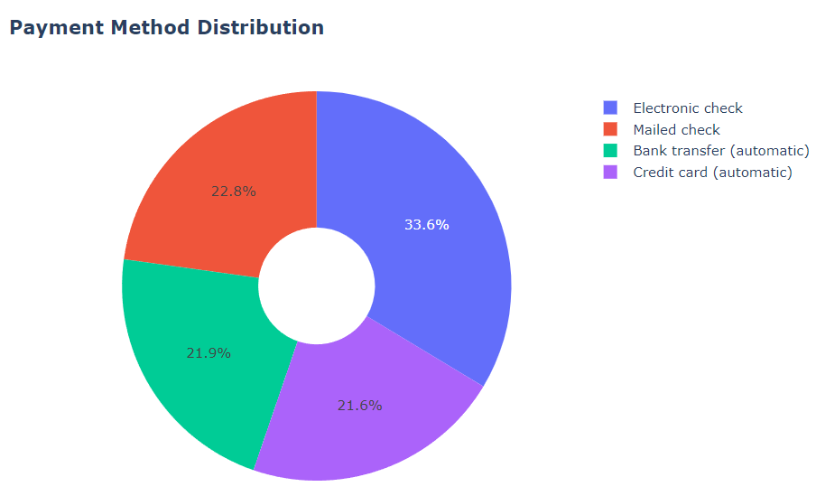

Slide 17
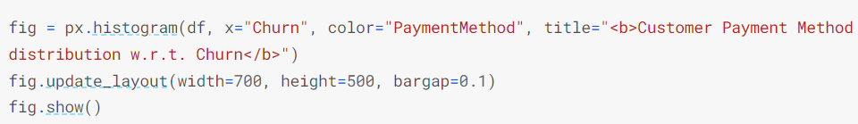
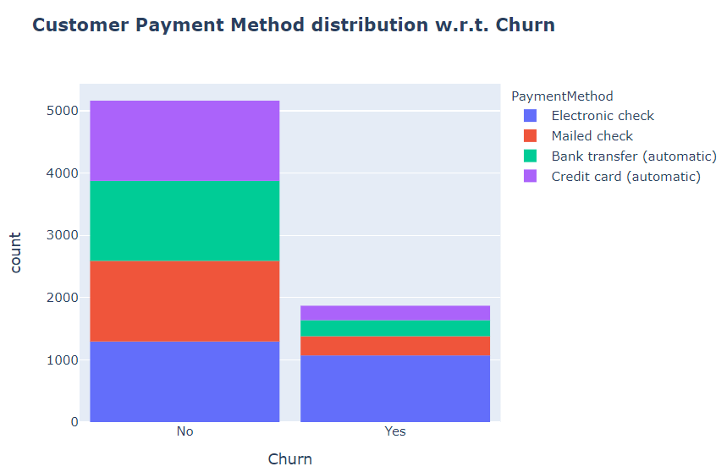
Major customers who moved out were having Electronic Check as Payment Method.
Customers who opted for Credit-Card automatic transfer or Bank Automatic Transfer and Mailed Check as Payment Method were less likely to move out.

Slide 18
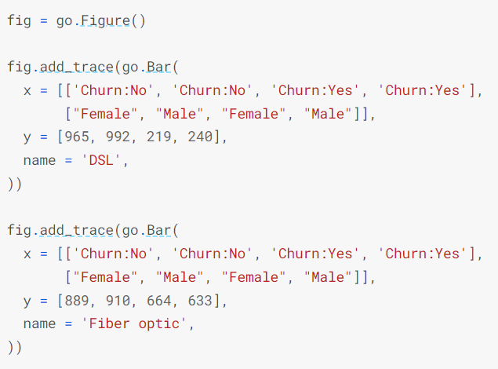
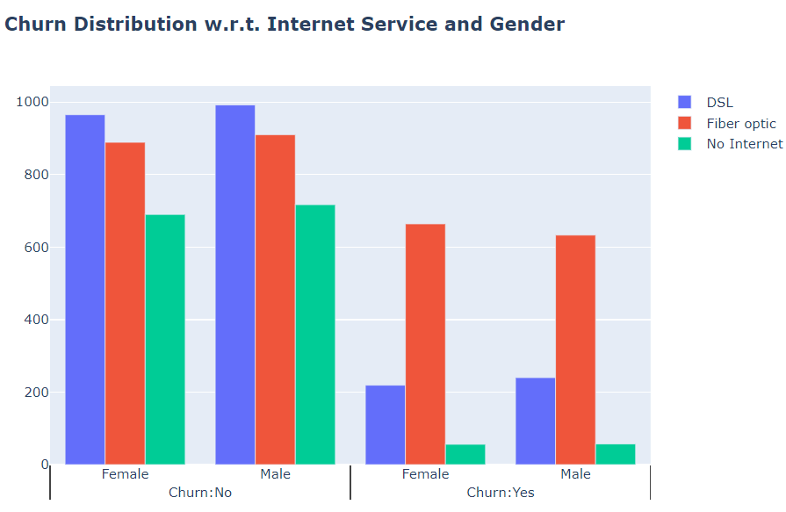
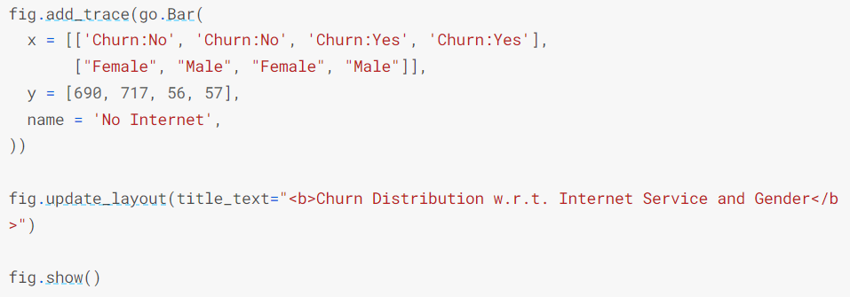
A lot of customers choose the Fiber optic service and it's also evident that the customers who use Fiber optic have high churn rate, this might suggest a dissatisfaction with this type of internet service.
Customers having DSL service are majority in number and have less churn rate compared to Fibre optic service.

Slide 19
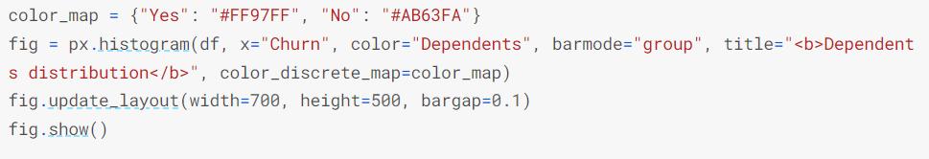
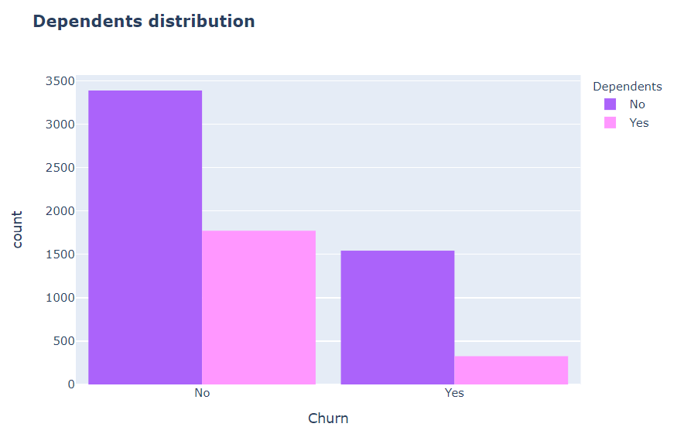
Customers without dependents are more likely to churn

Slide 20
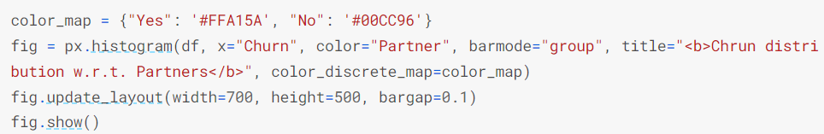
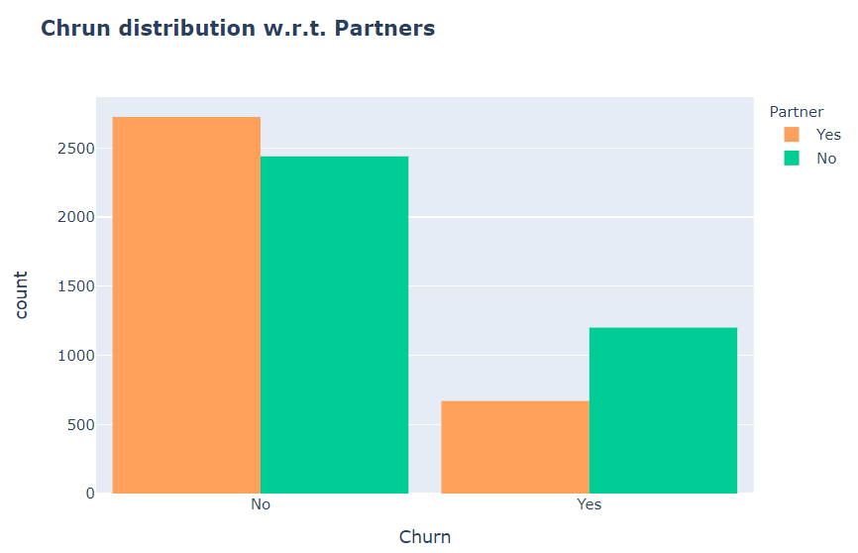
Customers that doesn't have partners are more likely to churn

Slide 21
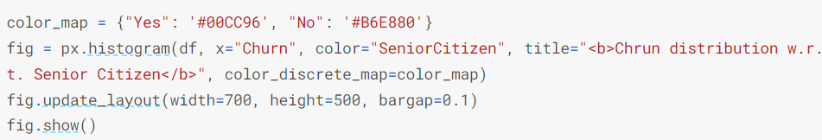
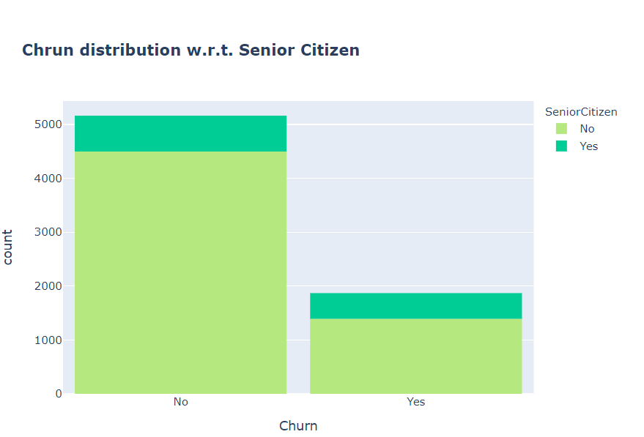
It can be observed that the fraction of senior citizen is very less.
Most of the senior citizens churn.

Slide 22
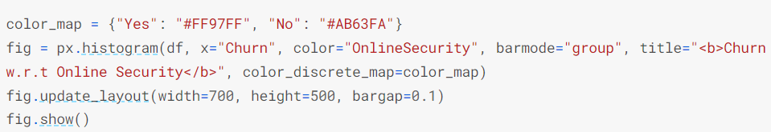
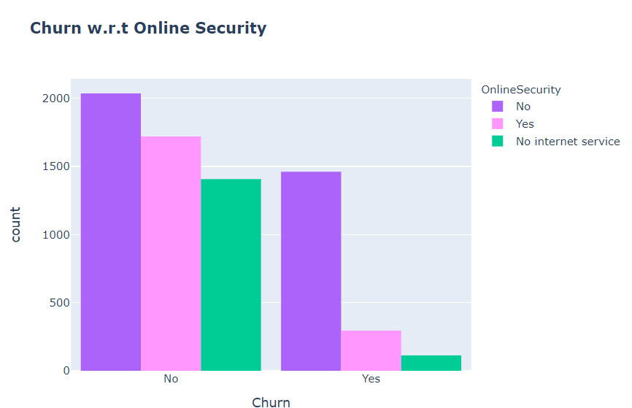
Most customers churn in the absence of online security.

Slide 23
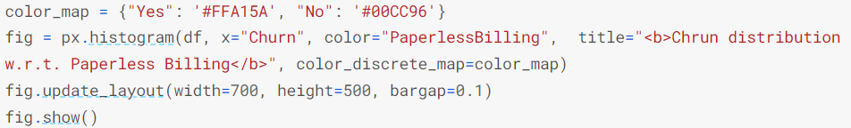
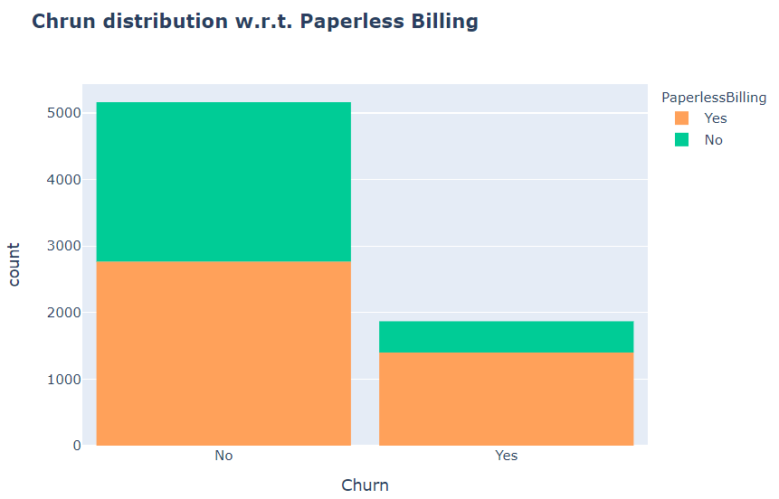
Customers with Paperless Billing are most likely to churn.

Slide 24
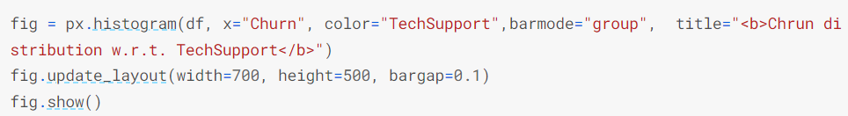
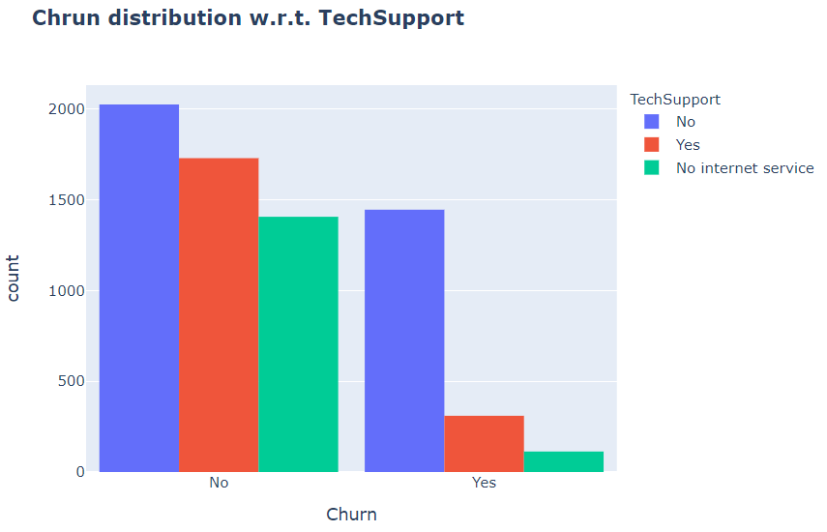
Customers with no TechSupport are most likely to migrate to another service provider.

Slide 25
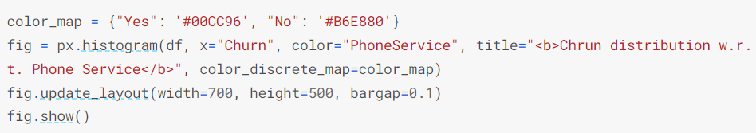
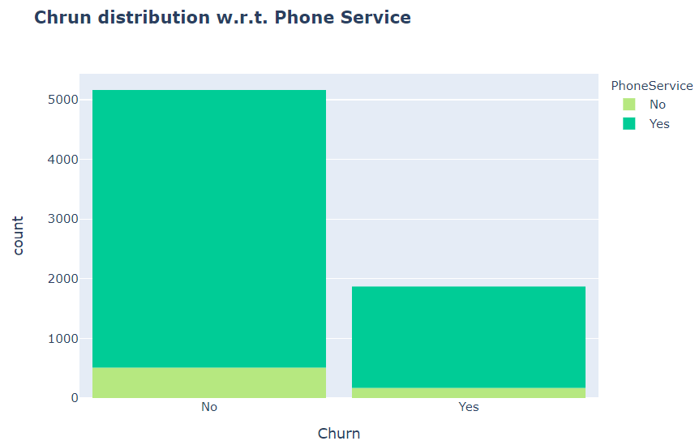
Very small fraction of customers don't have a phone service and out of that, 1/3rd Customers are more likely to churn.

Slide 26
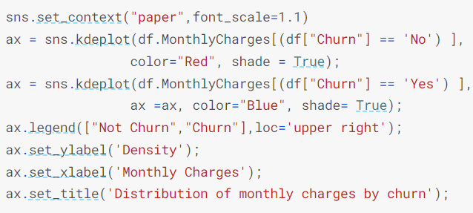
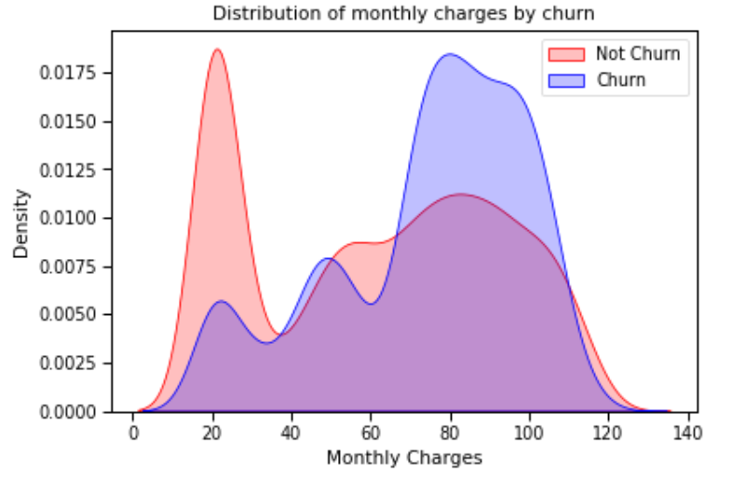
Customers with higher Monthly Charges are also more likely to churn

Slide 27
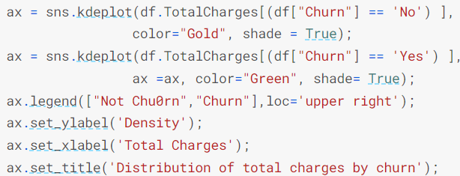


Slide 28


New customers are more likely to churn

Slide 29





7. Data Preprocessing

Slide 30




Slide 31


8. Machine Learning Model Evaluations and Predictions
KNN :
SVC

Slide 32




Random Forest

Slide 33




Random Forest ROC Curve:
Logistic Regression

Slide 34




Logistic Regression Confusion Matrix
Logistic Regression ROC Curve

Slide 35




Decision Tree Classifier
AdaBoost Classifier
Decision tree gives very low score.

Slide 36





Adaboost Classifier Confusion Matrix
Gradient Boosting Classifier

Slide 37




Voting Classifier :
Let's now predict the final model based on the highest majority of voting and check it's score.

Slide 38


Slide 39


